Slide 1

JavaScript Advanced
Course Introduction
SoftUni Team
Technical Trainers
Software University
https://softuni.bg

Slide 2
Table of Contents
Introduction
Course Objectives
Trainers and Team
Course Details

Slide 3
Have a Question?
sli.do
#js-advanced

Slide 4














SoftUni Diamond Partners

Slide 5

Educational Partners

Slide 6

JS Advanced
Course Objectives

Slide 7
Course Objectives
Extends the JS Fundamentals course
Advanced coding skills for the JS language
Use contemporary techniques and paradigms
Master the DOM API and user interaction
Write code to solve realistic practical problems

Slide 8


Learn to Search in Internet
The course assignments require to search in Internet
This is an important part of the learning process
Some exercises intentionally have no hints
Learn to find solutions!
Software development includes everyday searching and learning
No excuses, just learn to study!
Developers learn new technologies, tools, languages every day!

Slide 9
JS Advanced – Course Topics
Syntax, Functions and Statements
Arrays & Matrices
Objects & Composition
DOM Introduction
DOM Events and Manipulation

Slide 10
JS Advanced – Course Topics
Advanced Functions
Unit Testing
Classes
Prototypes and Inheritance
Workshop

Slide 11

Trainers and Team

Slide 12

Viktor Kostadinov
Senior technical trainer with 6 years experience in the IT field
Front-End Instructor at Amusnet Interactive
Former Head of the R&D Unit at Software University
Former Director of the Education Department
JavaScript enthusiast

Slide 13
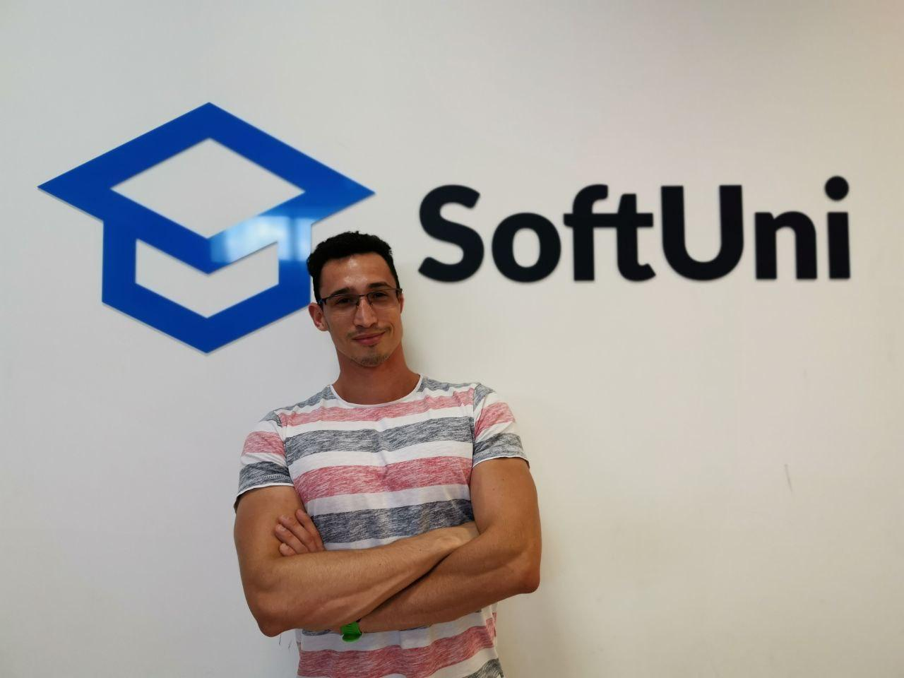
Dimitar Krastanov
3 years of experience as a Trainer at Software University
Front-End Developer at Mobile Wave Solutions
Interests in Full Stack Development
Experience with JS, ReactJS, TypeScript

Slide 14

Course Details
Schedule

Slide 15

Practical Exam
Structure: 3 problems for 4 hours
Exam: 18 Feb 2023
Retake: 5 Apr 2023
Problems description:
DOM
Classes
Unit Testing
Link to Exams

Slide 16
Theoretical Exam
20 questions for 30 minutes
Multiple-choice
English
Automated quiz system
Available online
You can submit your answers just one time

Slide 17
JS Advanced Module Timeline
JS Advanced
Start: 10. Jan 2023
Exam: 18. Feb 2023
10.
18.
6 weeks
4 times per week
Jan
Feb
JS Applications
Start: 21. Feb 2023
Exam: 01. Apr 2023
21.
01.
6 weeks
4 times per week
Feb
Mar
Apr
Exam Retakes
JS Advanced: 5. Apr 2023
JS Applications: 11. Apr 2023
Apr

Slide 18
Course Scoring
Practice grade:
Theory grade:
SoftUni Certificate: 5.00 from Practice
CPE Certificate: 3.00 average from Practice + Theory
Practical Exam
Homework
100 %
+5 %
Theoretical Exam
100 %
18

Slide 19




Course Web Site, Forum and FB Group
Official web site:
Official discussion forum:
Official Facebook group:
Official SoftUni JavaScript Community:
https://softuni.bg/trainings/3961/js-advanced-january-2023
softuni.bg/forum/categories/19/
www.facebook.com/groups/JsAdvancedJanuary2023
facebook.com/groups/SoftUniJavaScriptCommunity/

Slide 20
Questions?
Notes:
20

Slide 21
Trainings @ Software University (SoftUni)
Software University – High-Quality Education, Profession and Job for Software Developers
softuni.bg, softuni.org
Software University Foundation
softuni.foundation
Software University @ Facebook
facebook.com/SoftwareUniversity
Software University Forums
forum.softuni.bg
Notes:
21

Slide 22

License
This course (slides, examples, demos, exercises, homework, documents, videos and other assets) is copyrighted content
Unauthorized copy, reproduction or use is illegal
© SoftUni – https://about.softuni.bg/
© Software University – https://softuni.bg
Notes:
22

